Slide 1
SUICIDE
Contd.

Slide 2
How to determine social causes and social types of suicide
System of classification
‘etiological’ - the study of causes
‘morphological’ - form and structure

Slide 3
Etiological System of Classification
There are as many types of suicide as there are special causes producing them.
Specific type of suicide would correspond to classes/types -
created by organizing the social conditions (on the basis of their resemblances and differences) responsible for them.

Slide 4
Studying suicide
Presumptive motives of suicide – do the statistical records of these constitute data?
Poverty, losses, family troubles, love, jealousy, remorse, physical pain, religious mania, anger, fear of criminal sentence, unknown causes.
Are the apparent causes (motives) the real causes? These only imperfectly express the real causes.

Slide 5
Classification of suicides into three major groups on the basis of social factors/integration/regulation
Egoistic Suicide: excessiveness of the individual personality
Altruistic Suicide: sacrifice of the personality
Anomic Suicide: individual sensitivity to ideas of social progress/change
Fourth: Fatalistic Suicide – excessive regulation

Slide 6
Explanation in terms of other social facts
Forsaking individual motives, one must seek directly the states of the various social environments –
religious confessions (religion)
Family (marriage)
political society
occupational groups etc.
in terms of which the variations of suicides occur.

Slide 7
Egoistic Suicide
Durkheim takes up three factors:
The relationship of suicide with religious confessions
The relationship of suicide with the family
The relationship of suicide with ‘political society’.

Slide 8
Exploring the variations in suicide
Durkheim discusses religion, family and political life as forms of society which bind and integrate individuals to their world.
Explores first correlations between suicide rates and the above factors.
Then explains them in terms of the measure of solidarity afforded by these institutions.

Slide 9
Suicide patterns in Europe according to religion
In Europe, a correlation between Protestantism, Catholicism and Judaism and the rate of suicide.
Highest for the Protestants.
Catholic countries (Italy, Spain, Portugal) show little suicide while Protestant countries like Prussia, Saxony, Denmark show maximum suicide.

Slide 10
Contd.
Switzerland has both French and German nationalities; here, too, Catholic cantons show less suicide than Protestant, of whichever nationality.
Jews have a lesser rate of suicide than either the Protestants or the Catholics.

Slide 11
What is the explanation for these facts?
Is it because Catholics and Jews are in a minority and this forces them to more rigorous moral discipline?
Argues that this is not the explanation because even in Spain where Catholics are not in a minority they tend to commit suicide less.

Slide 12
Nature of the religious confession the explanation
The difference between Catholicism and Protestantism as religions.
A Catholic accepts his faith ready made, without scrutiny. “All variation is abhorrent to the Catholic”.
The Protestant is more the author of his faith – religious individualism is stressed.

Slide 13
How a religion binds an individual to itself and to society
Protestantism concedes greater freedom to individual thought than Catholicism because it has fewer common beliefs and practices.
The higher rate of suicide among Protestants is thus to be explained by the fact that it is a less integrated church than the Catholic church.
Importance of possession of a common, collective credo.

Slide 14
Protestantism and the spirit of free enquiry
Protestantism – permits ‘free enquiry’ to a greater degree than Catholicism.
But can free enquiry be the cause of a higher rate of suicide?
Durkheim argues that reflection develops when ideas and sentiments which had earlier guided conduct become ineffective.

Slide 15
Free enquiry, learning and suicide
The more you learn, the more your beliefs weaken; hence suicide should increase with the acquisition of knowledge
Protestants more educated than Catholics
Women less educated than men
Jews – more education but less suicide, Why?
“The Jew has all the intelligence of modern man without sharing his despair”

Slide 16
Is knowledge the cause of suicide?
No
Man kills himself because of the loss of cohesion in his religious society; he does not kill himself because of his learning. The desire for knowledge wakens because religion become disorganized.

Slide 17
Anomalies
England is Protestant - yet has less suicide – because the Anglican church is far more integrated; has a hierarchical clergy.
Jews – intellectual, spirit of free enquiry, yet have less suicide?
Jewish church very strongly united due to the hostility of the surrounding populations; religious society creates solidarity.

Slide 18
Egoistic Suicide
As a society weakens or disintegrates, the individual depends less on the group and more upon himself, and recognizes no rules of conduct beyond those based upon private interests.
A state of “excessive individualism” - egoism develops leading to egoistic suicide.

Slide 19
Hence, Durkheim’s general proposition: “Suicide varies inversely with the degree of integration of social groups of which the individual forms a part”.
If group is weak, the individual becomes more dependent on himself; recognizes no rules of conduct except those based on his own private interests.
Personal troubles felt less deeply in integrated societies.

Slide 20
Contd.
Egoism means detachment from social ends; but these very social ends are needed to give meaning to life.
The bond attaching man to life relaxes because that attaching him to society itself is slack.

Slide 21
How does excessive individualism lead to the suicidal urge?
An egoist feels weary, sad and depressed, letting go of all activity; in this case he elevates himself beyond collective constraints.
Women commit suicide less because they are less involved in collective (public) life; the same with children and with old people.

Slide 22
Marriage, family and suicide
A new study finds that divorced and separated men are two and a half times more likely to commit suicide than married men.
Divorce, however, doesn't seem to lead more women to commit suicide -- a surprising finding considering the popular wisdom that women suffer more than men after a divorce, according to the study, published in the Journal of Epidemiology and Community Health.
Unlike prior research on marriage and suicide, this study shows that widowed and single people weren't at higher risk for suicide.

Slide 23
Durkheim’s proposition
Marriage, according to Durkheim has a preservative effect against suicide – for men.
Family unit provides immunity to both husband and wife.
Immunity increases with the size of the family.

Slide 24
India
A study of Indian data by Peter Mayer reveals that while marriage provides better protection against suicide for Indian women it does not do so for Indian men.
Changed circumstances for men and women?

Slide 25
Political Society and Suicide
Rare in a society’s early stages; increases as society matures.
Suicide goes down during social disturbances and great popular wars – because these cause a greater integration of society.
Is it because records kept during disturbances are inadequate? Not so.
Also, not all political crises cause the drop; only those which excite the passions – in which people get involved.

Slide 26
Altruistic Suicide
The opposite of egoistic suicide: insufficient individuation.
Among simpler and traditional societies: several such categories of suicide – old men; women on the death of their husbands, followers and servants upon the death of their chiefs.

Slide 27
Altruistic Suicide (contd.)
The person kills himself because he sees it as his duty. Society imposes this sacrifice and for society to be able to do so, the individual personality must have little value, a state called altruism.
“Obligatory altruistic suicide”
Optional altruistic suicide
Acute altruistic suicide
Suicide by old people, sick people, by followers,
Ritualistic Suicide - Santhara, Sati, Hara-kiri or Seppuku

Slide 28
Seppuku in Japan – ritualistic suicide
Seppuku, the ancient samurai ritual of suicide by self-stabbing, was long considered an honorable act of self-resolve such that despite the removal of cultural sanctioning, the rate of suicide in Japan remains high with suicide masquerading as seppuku still carried out both there and abroad.

Slide 29
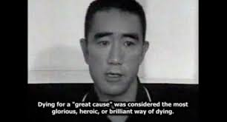
Seppuku, hara-kiri in Japan
Yukio Mishima, world famous Japanese novelist who committed Harakiri in 1975
Banned in 1991; yet cases up to 2001

Slide 30
Types of seppuku
Voluntary
Obligatory – for disgraced samurai (immoral conduct); losing in battle
At the death of one’s leader
Preferring death rather than defeat (after losing world war II
Loss of honour – failure in business

Slide 31
Sati in India – ritualistic suicide
Self-immolation by widow on funeral pyre of husband.
Earlier considered as obligatory
Today it is contested whether the woman commits it out of her own volition or is forced by family and society
Sati-mata temples glorify those women who commit sati

Slide 32
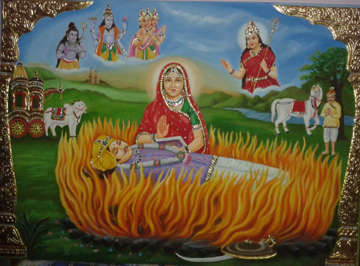
Religious sanction and glorification

Slide 33
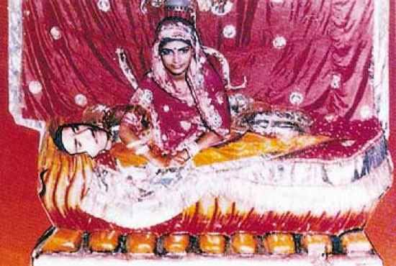
Roop Kanwar sati in 1987

Slide 34
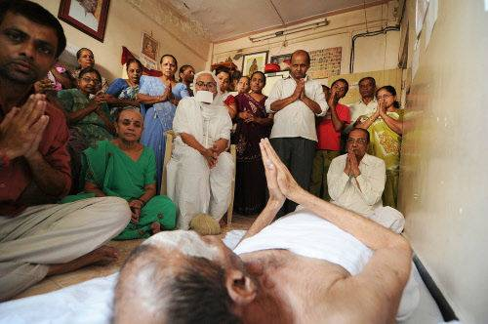
Santhara among the Jains – ritual fast unto death – ritualistic suicide

Slide 35
Contd.
Example of altruistic suicide in advanced societies – martyrs, revolutionaries, the army.
Suicide by military men; according to Durkheim their society is like those of earlier times.

Slide 36
The military as a society
“The soldier kills himself at the least disappointment, for the most futile reasons, for a refusal of leave, a reprimand or an unjust punishment, a delay in promotion, a question of honour, a flush of momentary jealousy, or simply because other suicides have occurred before his eyes or to his knowledge.”

Slide 37
Contd.
Altruistic suicide reflects a courageous indifference to the loss of one’s own life.
He seeks to strip himself of his personal being in order to be engulfed in something which he regards as his true essence.

Slide 38
Contd.
While the egoist sees no goal to which he might commit himself and thus feels useless and without purpose,
the altruist commits himself to a goal beyond this world, the world then becoming an obstacle and a burden to him.

Slide 39
Anomic Suicide
Economic Anomie
Domestic Anomie
Society’s ‘regulative’ function

Slide 40
Economic crises and suicide
Do economic crises lead to greater suicide?
Is it because they decrease wealth and increase poverty?
If so, suicides should keep on increasing with life becoming more difficult.

Slide 41
Evidence
Yet, sudden increases in economic prosperity also increase the suicide rate just as industrial and financial crises do.
If industrial and financial crises increase suicide, it is not because they cause poverty but because they are crises, that is, disturbances of the collective order.

Slide 42
Economic Anomie
How does this affect suicide? When society is disturbed by some crisis, its “scale” is altered and its members reclassified accordingly
in the ensuing period of disequilibrium, society is temporarily incapable of exercising its regulative function.

Slide 43
Economic Anomie
Durkheim called this state ‘anomie’. Temporary condition of ‘social deregulation’.
However, this state can be chronic in the sphere of trade and industry where the traditional sources of societal regulation religion, government and occupational groups – have failed to exercise moral constraints on an increasingly unregulated capitalist economy.
Hence, industrial and commercial occupations furnish the greatest numbers of suicides – economic anomie.

Slide 44
Domestic anomie
Afflicts widows and widowers and those who have experienced separation and divorce.
With frequent divorce, the immunity granted by marriage weakens.
Men need more regulation than women?

Slide 45
Needs, rewards and anomic suicide
Society creates needs; these needs must be regulated by society.
Society must legitimate functions and rewards; these are not immutable.
For humans to be happy, their individual needs and aspirations must be constrained, regulated.

Slide 46
Regulation and Integration
The regulatory function must be performed by an external, moral agency superior to the individual – i.e., by society.
Society determines the respective value of different social services, the relative reward allocated to each, and the consequent degree of comfort appropriate to the average worker in each occupation.

Slide 47
Contd.
In modern societies the rate of suicide has gone up – of both egoistic and anomic.
The types of causes of suicide are not necessarily found alone
Different causes may simultaneously afflict the same individuals, giving rise to composite modes of suicidal expression.

Slide 48
Contd.
Egoism and Anomie have a special ‘affinity’ for one another.
Under particular circumstances, anomie and altruism may come together.

Slide 49
How to address the ‘pathological’ rate of suicide?
Bond between individual and society must be re-established.
Not political society, not religion, not even family
Argued that in modern society, it is the occupational group that has the integrative potential. Work?
Pensions, welfare, insurance; rights and duties of the occupational group – the moral function of the occupational group – integrates as well as regulates.

Slide 50
How does society perceive suicide today?
In antiquity, it was a civil offense.
In modern times, suicide is viewed as a religious crime – one does not have the right to take one’s own life which is given to us by God.

Slide 51
Contd.
Christian conception of the human personality as a ‘sacred’ thing – man tinged with religious value – becomes a god for men – hence any attempt against his life suggests sacrilege.
Considered a criminal offence in many societies even today – punishable crime – those who attempt suicide may be imprisoned for up to a year.

Slide 52
In India
conflict between IPC Section 309 which criminalises attempt to suicide and the Mental Healthcare Act, 2017 which bars prosecution.
Decriminalization for all practical purposes

Slide 53
Contd.
In modern societies the human person is considered in some sense ‘sacred’ –
elevation of the individual personality - this view is what joins the members of society – hence the abhorrence of suicide.

Slide 54
On methods of committing suicide
Is there a causal relationship between the mode of the suicidal act and the nature of the suicide.
Societies place different instruments of death at one’s disposal, attaching differing degrees of dignity even to the various means available.

